Slide 1

Setting a place at the
Creative table

Slide 2
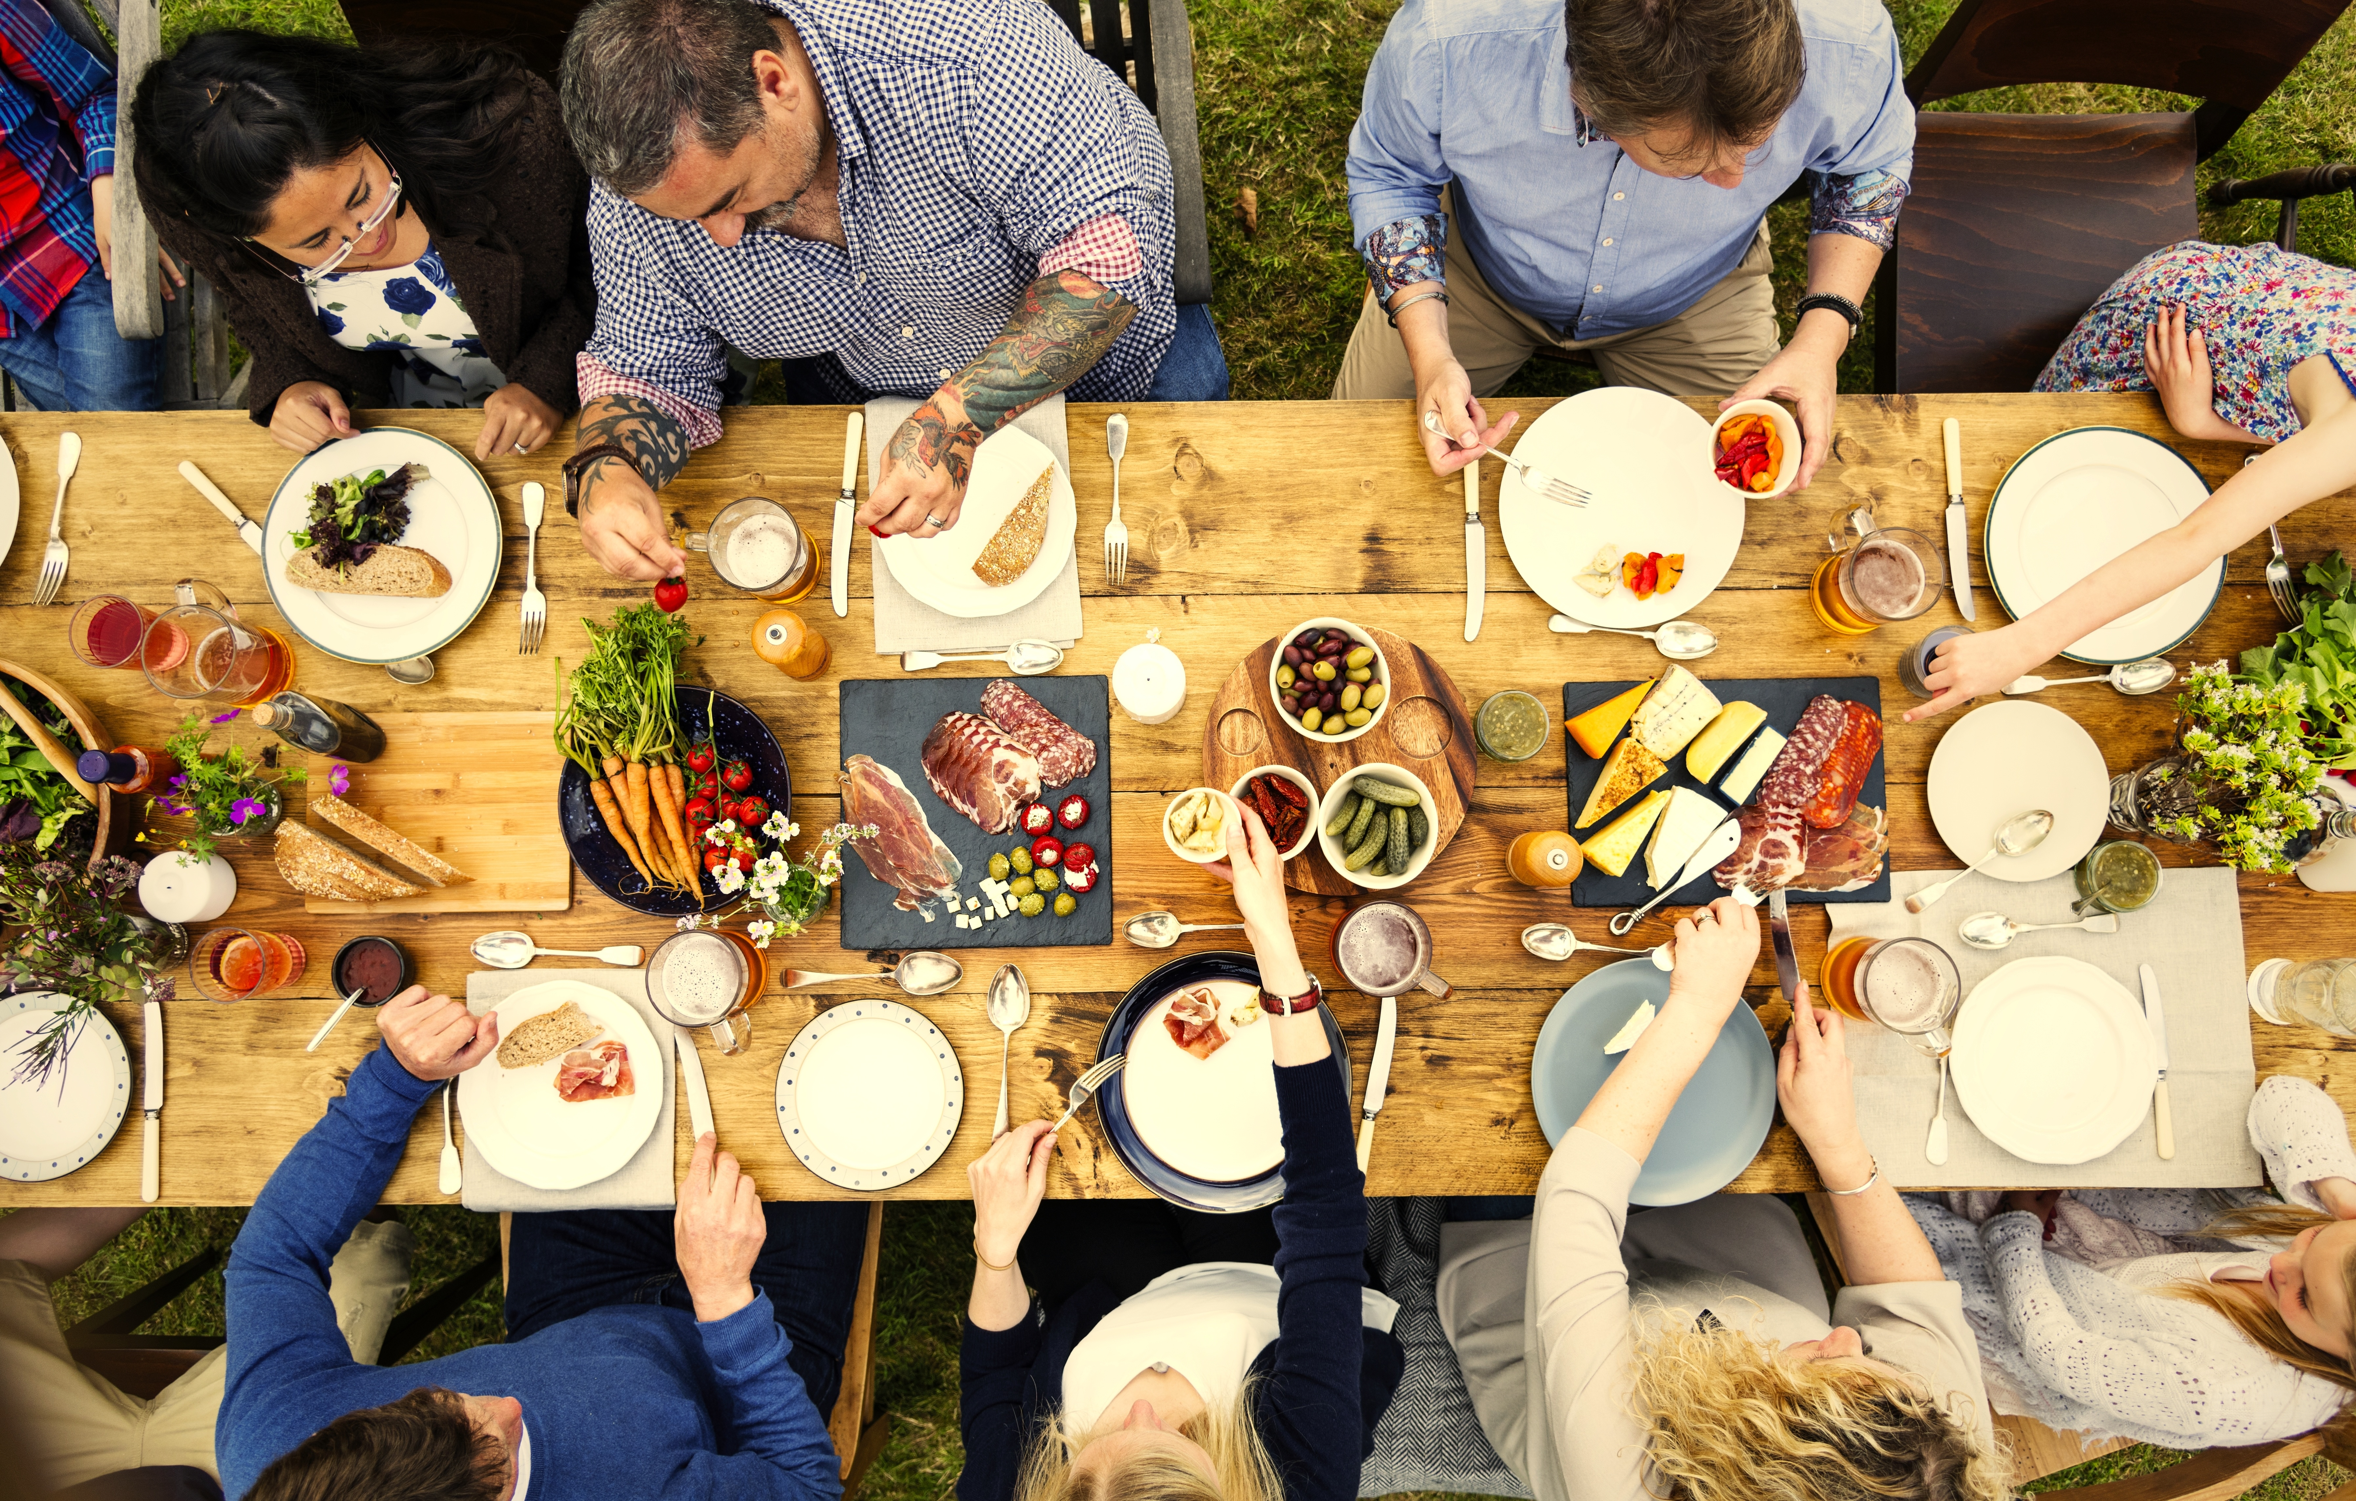

Slide 3
Start with hospitality
The dictionary defines hospitality as “being disposed to entertain with generous kindness.”
How to be “disposed” by being ready in detail and in spirit.
How to “entertain” yourself as well as others.
How to be “generous” by providing delicious and suitable food.
How to serve it “with kindness” so that guests are not dismayed by a do-it-herself hostess who deserts them for her kitchen.
General Mills, Inc., Betty Crocker’s Guide to Easy Entertaining

Slide 4
Chefs are inclusive designers
When I am putting together a menu for a dinner party there are a number of things I am considering.
Food allergies. No peanuts? No shellfish?
Food preferences: vegan, gluten-free, paleo
Age of guests
Mobility/dexterity of guests
Ability to chew certain foods
All of these things effect the menu I am planning.

Slide 5
Who is on the guest list?
Are you in or out?

Slide 6
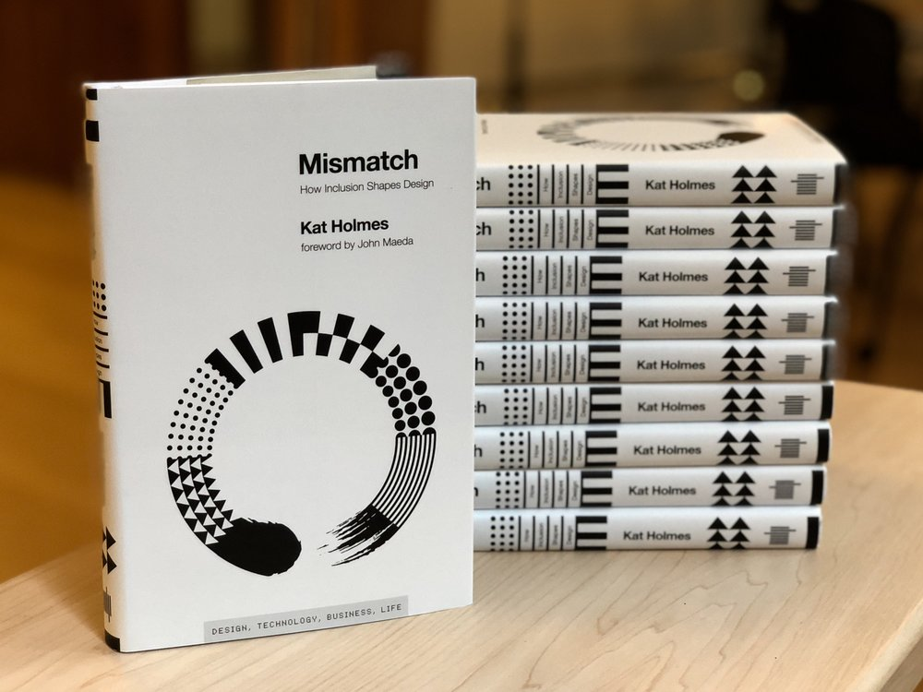
Mismatch: how inclusion shapes design
Credit: katholmesdesign.com

Slide 7


Slide 8
Inclusive Design
A methodology that enables and draws on the full range of human diversity. Most importantly, this means including and learning from people with a range of perspectives. (Microsoft Design)

Slide 9
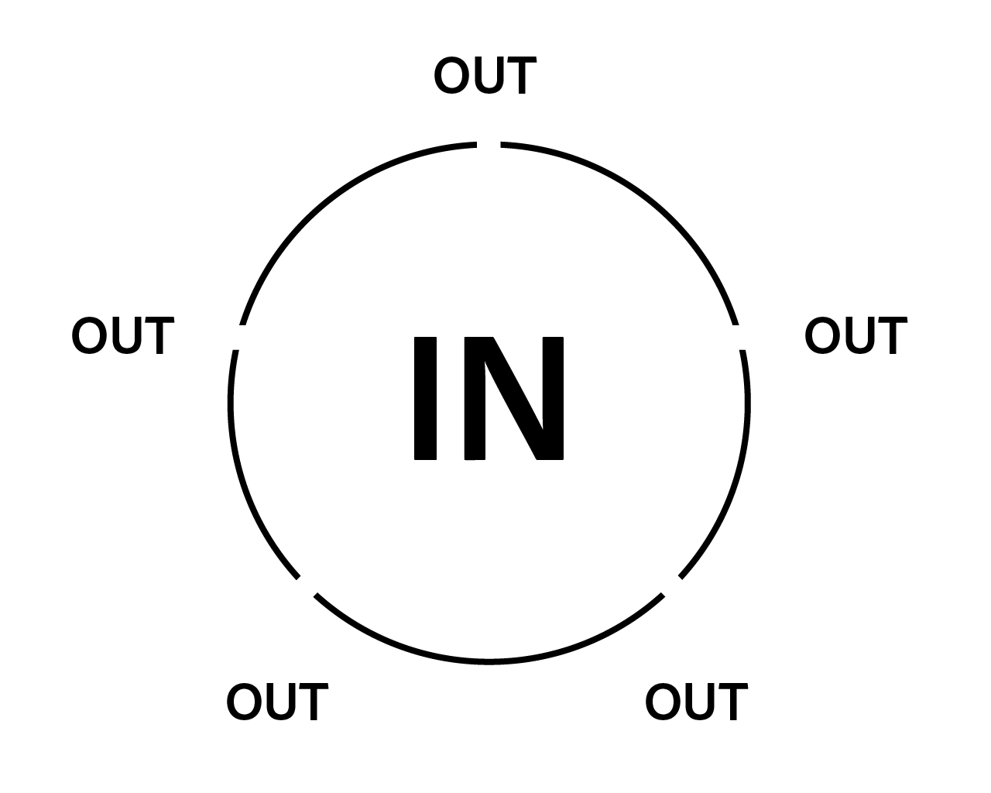

Slide 10
The right utensil for the job
Matched and mismatched interfaces

Slide 11


Slide 12


Slide 13


Slide 14


Slide 16


Slide 17


Slide 18


Slide 19


Slide 20


Slide 22


Slide 23
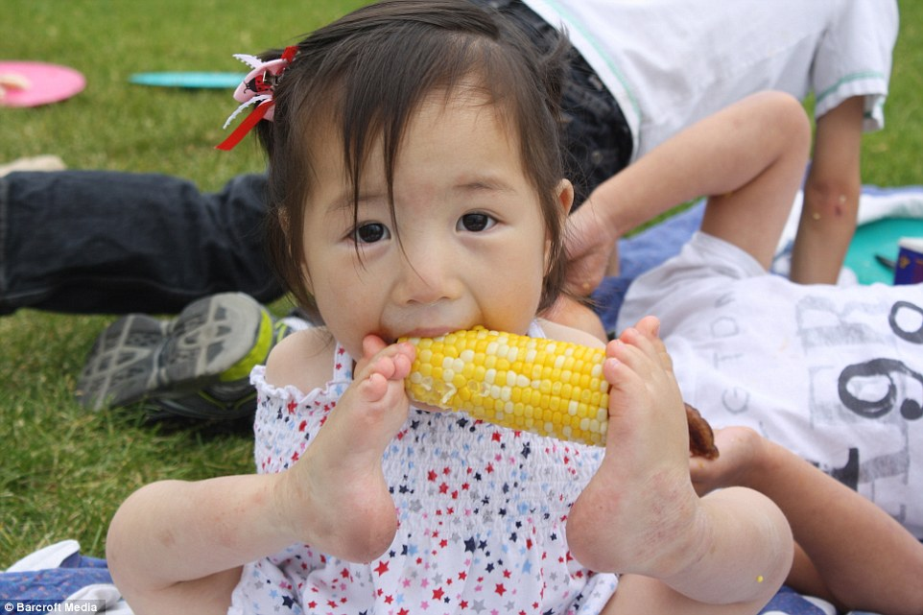

Slide 24
Reducing uncertainty
In and out of the kitchen

Slide 25
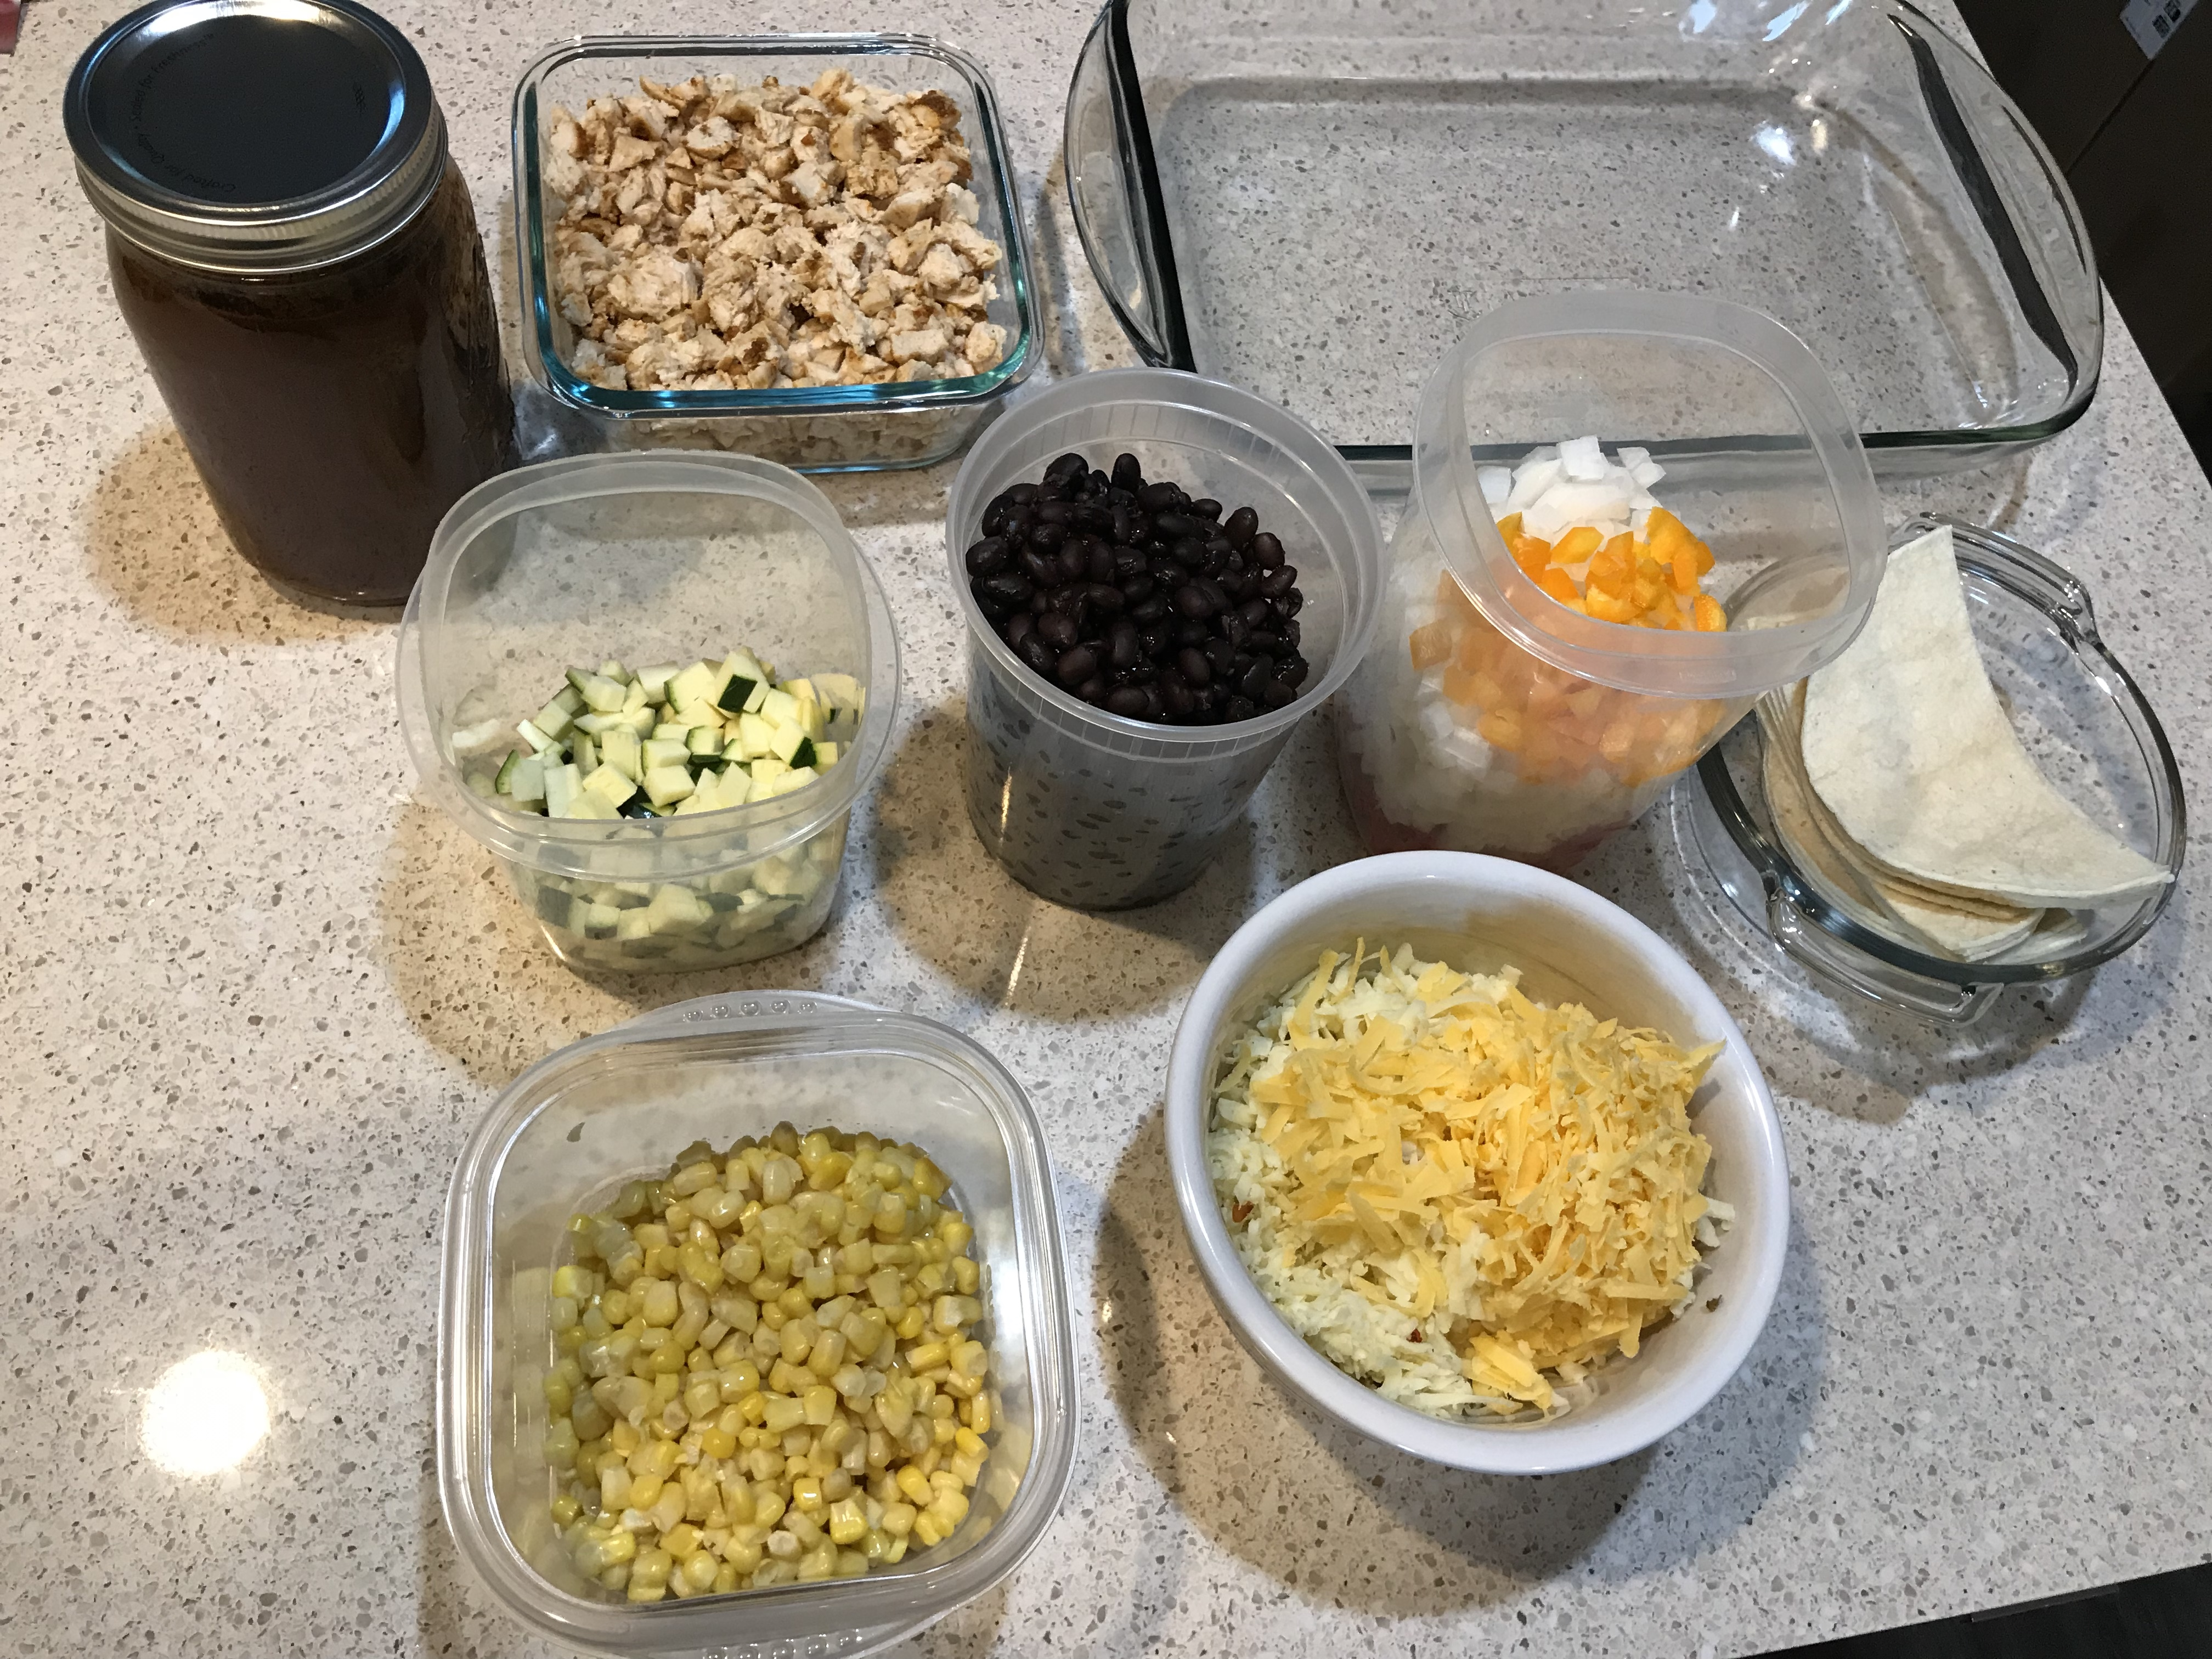
Mise en place (MEEZ ahn plahs)
A French cooking term meaning, “set in place”.

Slide 26
Designing for accessibility
Mise an place for designers

Slide 27
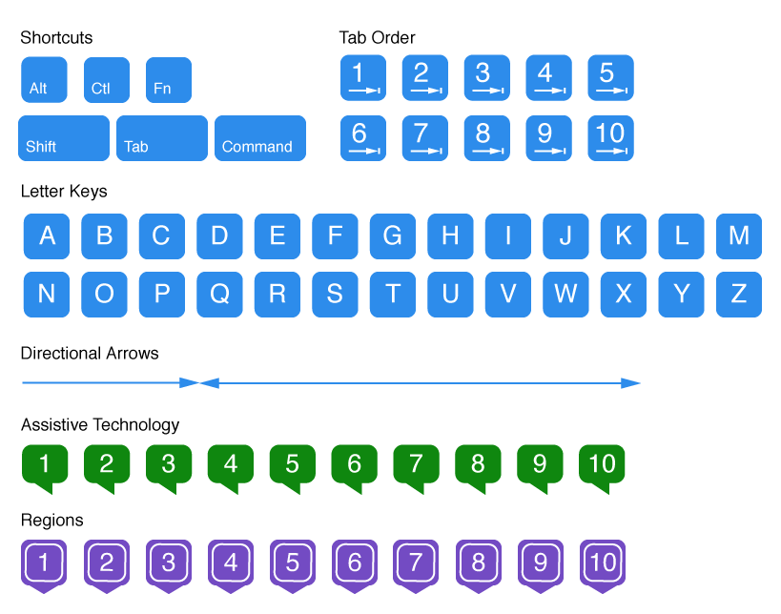
Accessibility Annotations

Slide 28
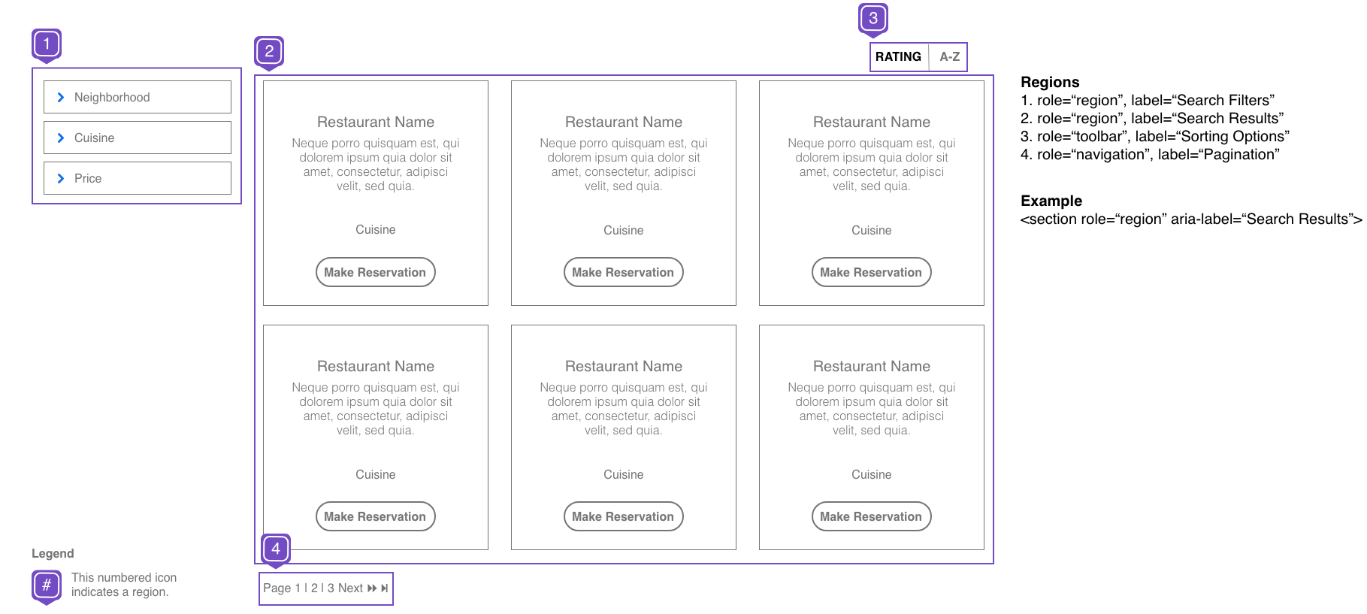
Regions

Slide 29
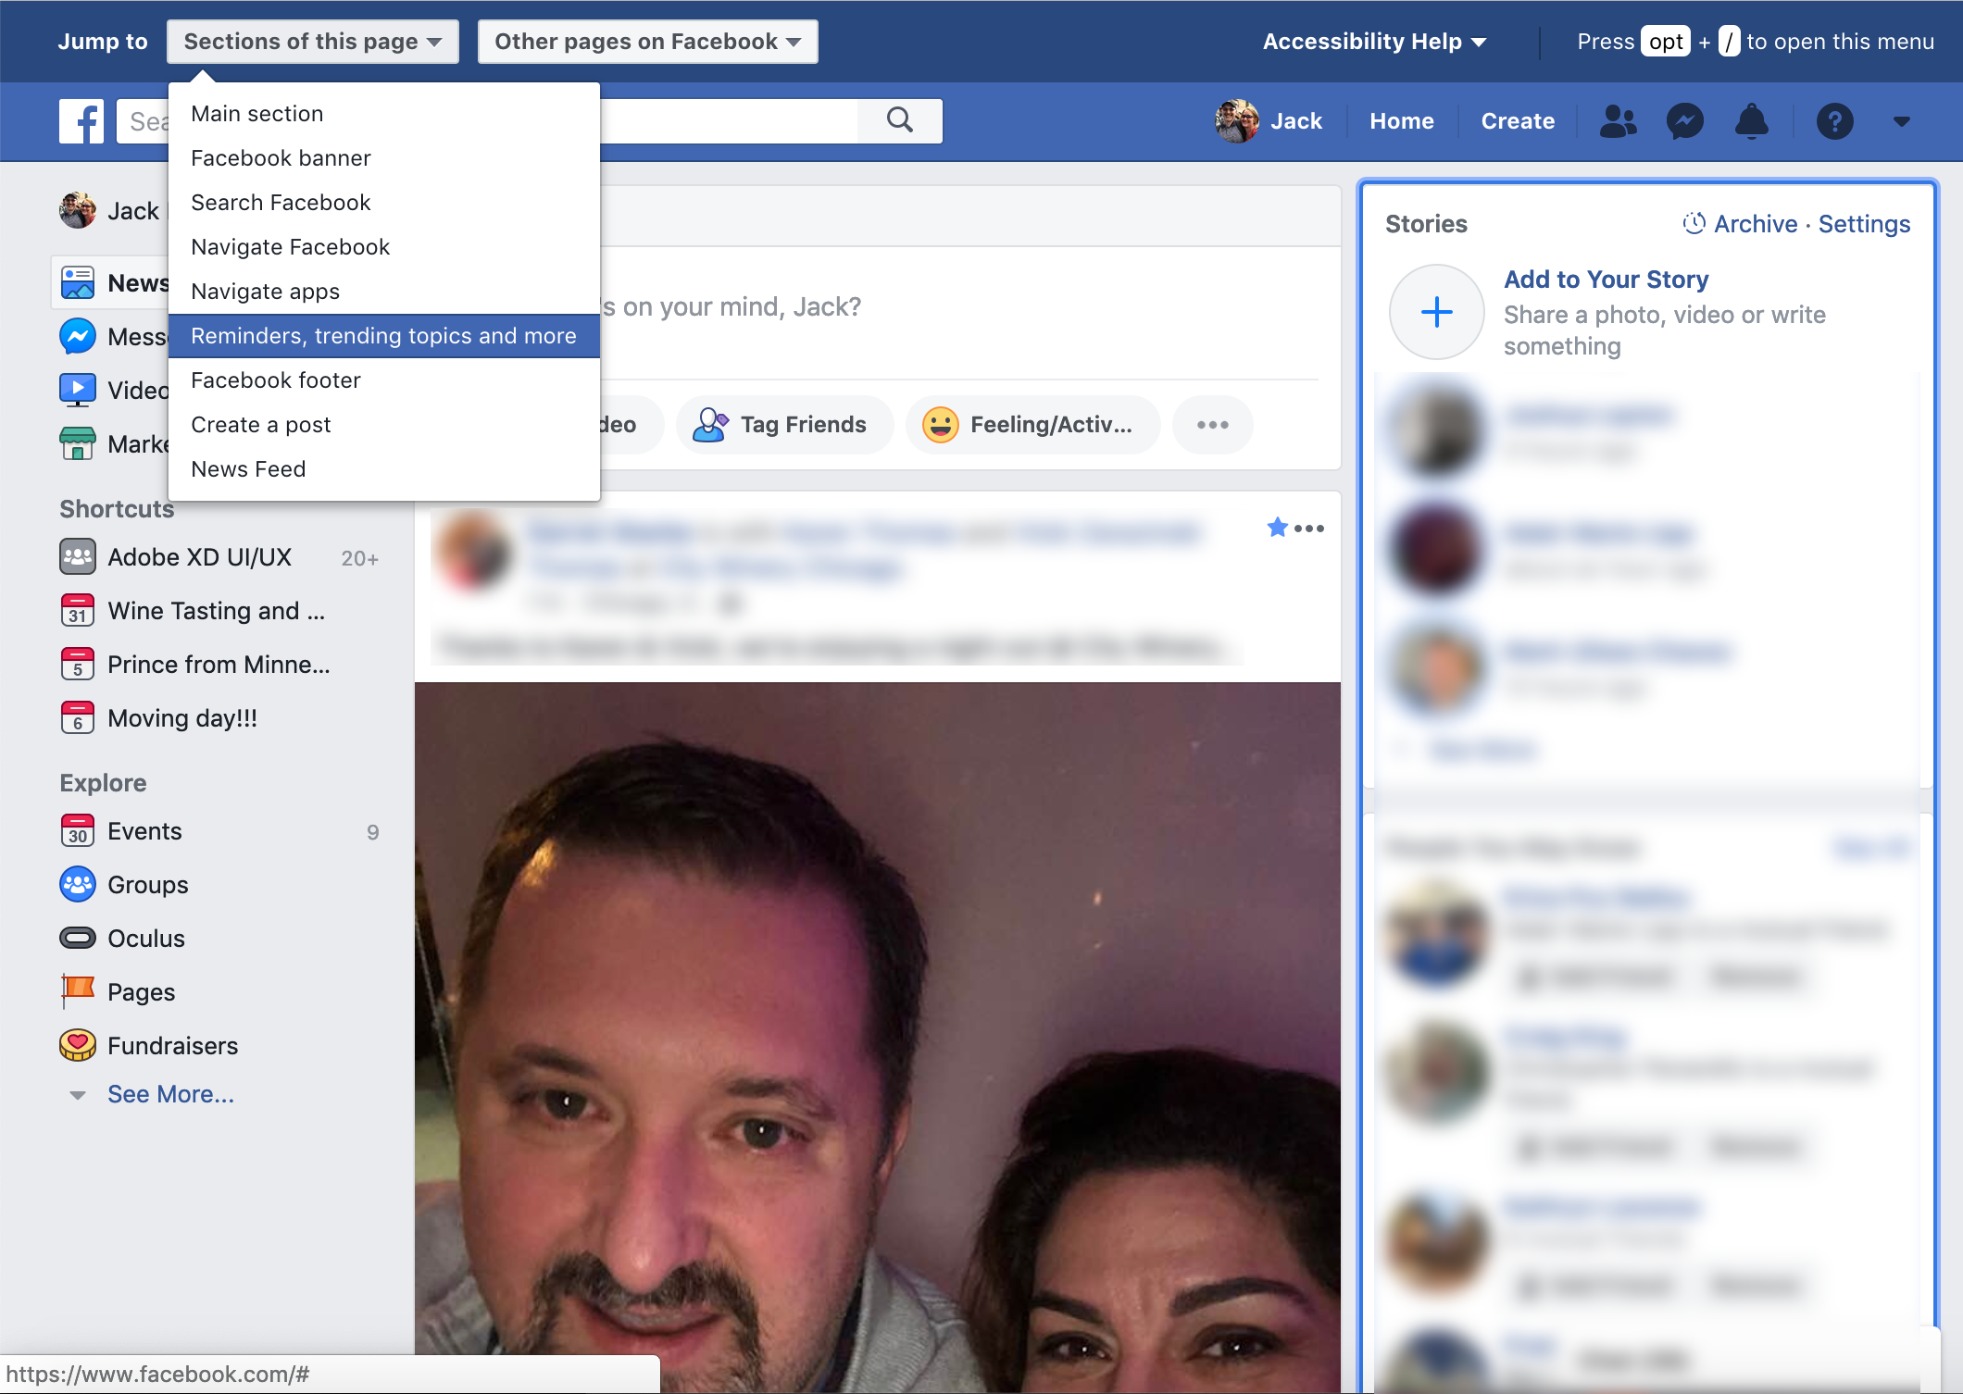

Slide 30
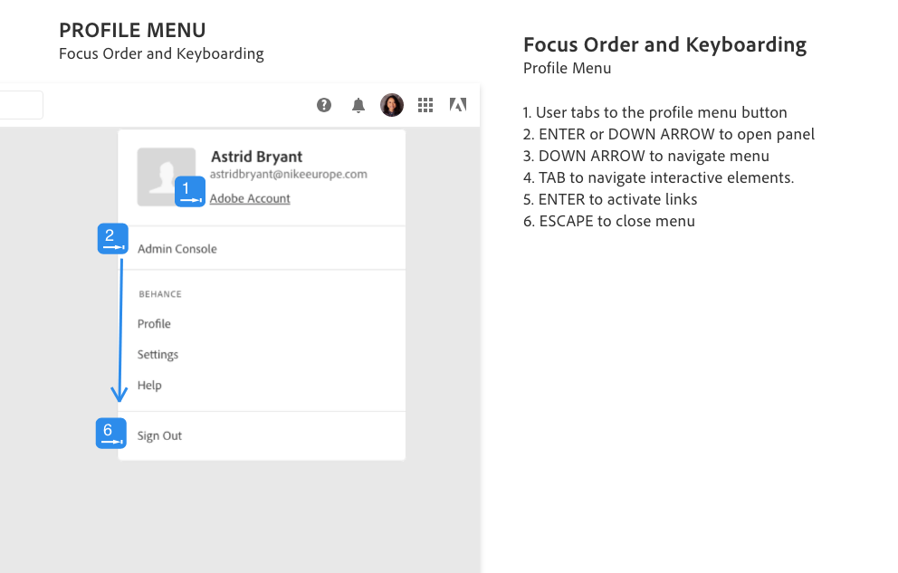
Focus and Keyboarding

Slide 31
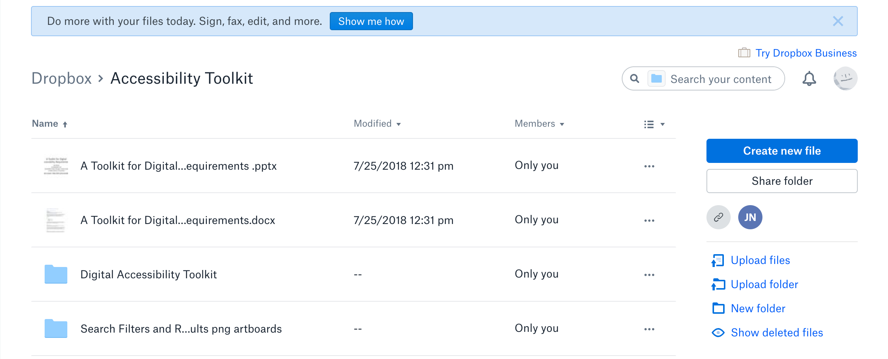

Slide 32


Slide 33
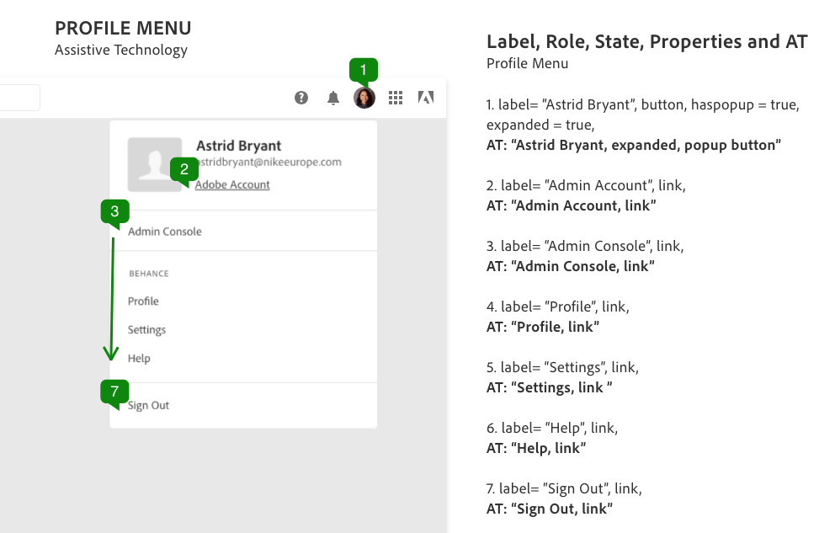
Name, role, state, properties and AT.

Slide 34
Color and content checks

Slide 35
Use quality ingredients
Design systems
UI component libraries
UX design patterns

Slide 36
Incorporating social factors
A study, Incorporating Social Factors in Accessible Design by Kristen Shinohara, Jacob O. Wobbrock, and Wanda Pratt.
The study took into account social factors when conducting UX research and testing.
They found beneficial outcomes when disabled and nondisabled users were grouped together with a designer working on a solution.

Slide 37
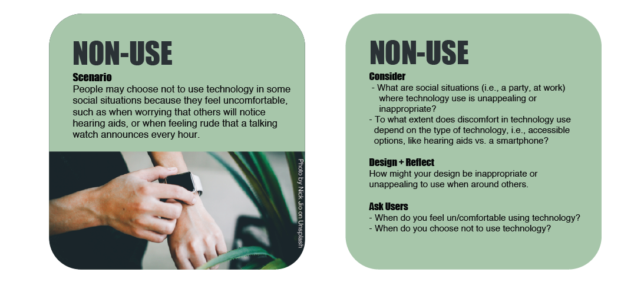
Method Cards

Slide 38
Seasoning to taste
Fixing what’s broken

Slide 39
Adobe now and in the future

Slide 40
Janie

Slide 41


Slide 42

Photoshop at your fingertips

Slide 43
Setting a place for Janie
at the Creative table

Slide 44
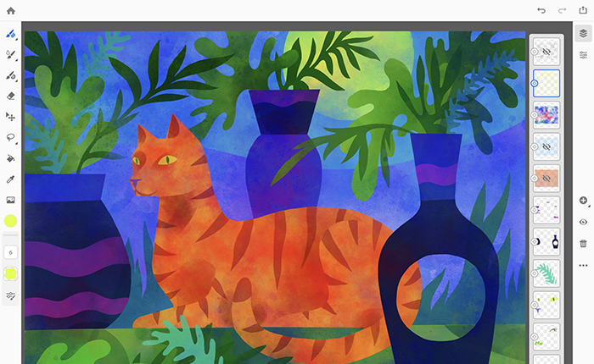
Project Gemini

Slide 45
The Top Chef Challenge

Slide 46
Ability-based Design
“A design approach in which the human abilities required to operate an interactive system are questioned, and systems are made operable by and adaptable to alternative abilities.”
“Everyone has abilities, some people have more than others. We need to design for people with abilities of all types.” – The concept of “Positive affirmation of ability.”
- Jacob Wobbrock

Slide 47
Adaptive software
Using Artificial Intelligence and Machine Learning to build software which adapt to the abilities of the current user.
The user interface is separated from the business logic so that new interfaces can be crafted when presented with new abilities. The software would learn how to adapt to the new interface.

Slide 48
Changing our thinking
Accommodating our guests

Slide 50
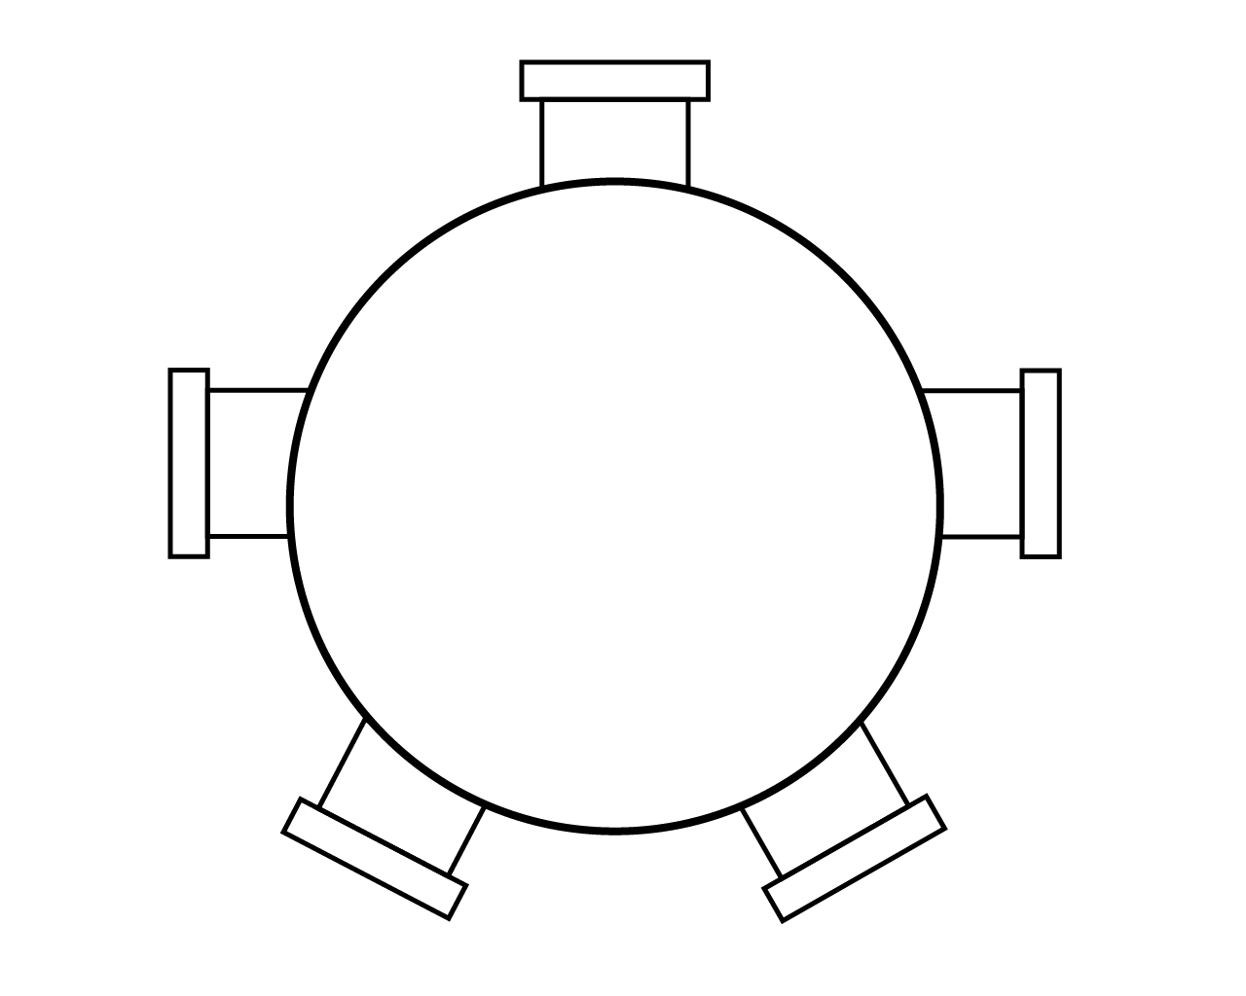

Slide 51
We know we’ve set the table when…
ability (not disability) drives success for creatives in the workforce.
companies big and small employ designers representing a range of abilities.
We validate our designs throughout the design process, with users of various abilities, incorporating social factors (because we can’t design alone).

Slide 52
We get there by…
Mise en place
Involving users, inviting them to the table
Shifting our perspective
Creating flexible and adaptive products

Slide 53
Thank you. Bon Appetit.

Slide 54
Questions?

Slide 55
Jack Nicolai nicolai@adobe.com
Accessibility Product Manager, Creative Cloud at Adobe Systems, Incorporated

Slide 56
Resources
Jack Nicolai – Digital Accessibility Toolkit
Kat Holmes – Inclusive Design Toolkit
IBM Carbon Design System/accessibility
IBM Accessibility Checklist
Microsoft Inclusive Design /accessibility, Fabric UI Toolkit
Google Material Design /accessibility

Slide 57
References
General Mills, Inc. Betty Crocker’s Guide to Easy Entertaining, Golden Press, 1959, pp. 7.
Holmes, Kat. Mismatch: how inclusion shapes design, The MIT Press, 2018, pp. 36-37, 71-72.
“Mise en Place: Cook Like a Pro”, D'Artagnan, D'Artagnan, https://www.dartagnan.com/mise-en-place-cook-like-a-professional.html.
Shinohara, K., Wobbrock, J.O. and Pratt, W. (2018). Incorporating social factors in accessible design. Proceedings of the ACM SIGACCESS Conference on Computers and Accessibility (ASSETS '18). Galway, Ireland (October 22-24, 2018). New York: ACM Press, pp. 149-160.
Wobbrock, J.O. (2017), Ability-Based Design: Elevating ability over disability in accessible computing, 2017 ACM SIGCHI, Social Impact Award, Denver, CO.

Slide 58
Links
Learn more about Kristen Shinohara and sign up to be notified when Kristen's Methods Cards become available.
Learn more about Jacob O. Wobbrock on his UW faculty website.

