Slide 1
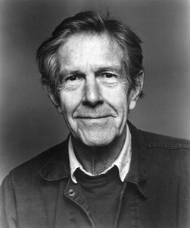
Accessible user experiences in 4’33”
Ian Pouncey

Slide 2
Notes:
John Cage

Slide 3
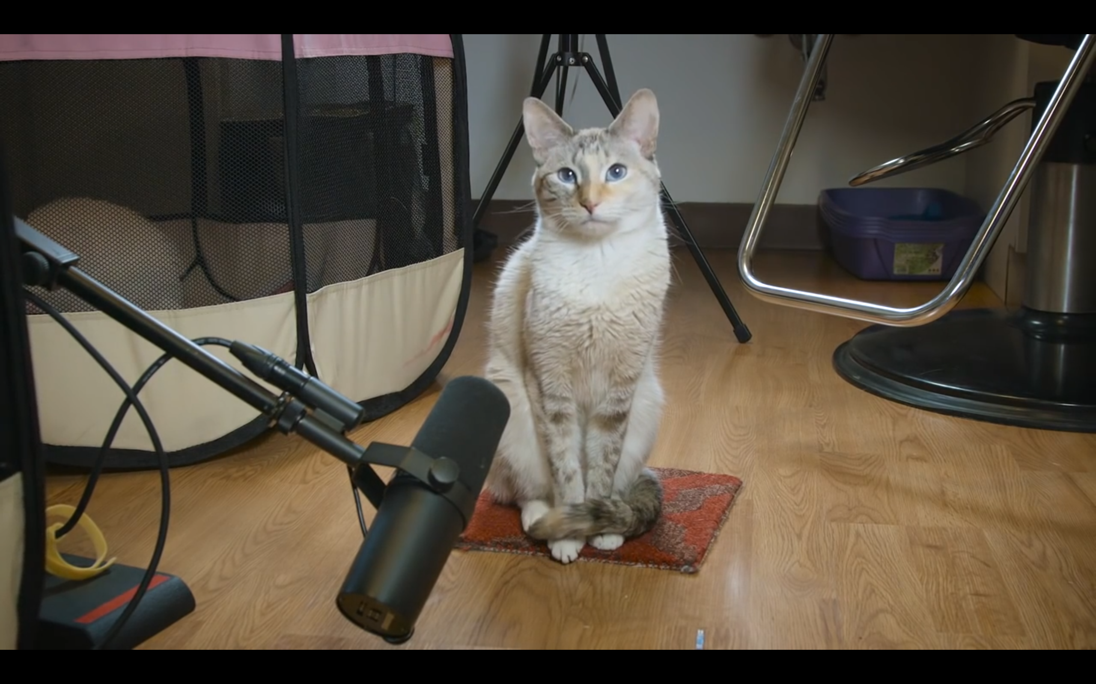
Notes:
NOLA the cat, The Late Show with Stephen Colbert

Slide 4
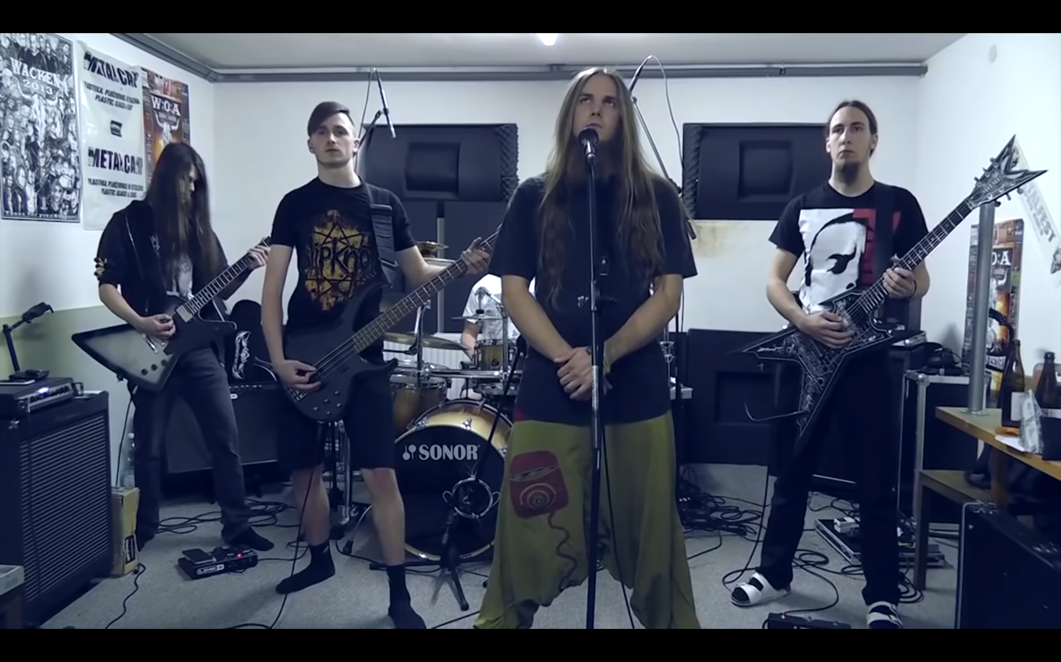
Notes:
Death Metal Cover by Dead Territory

Slide 5
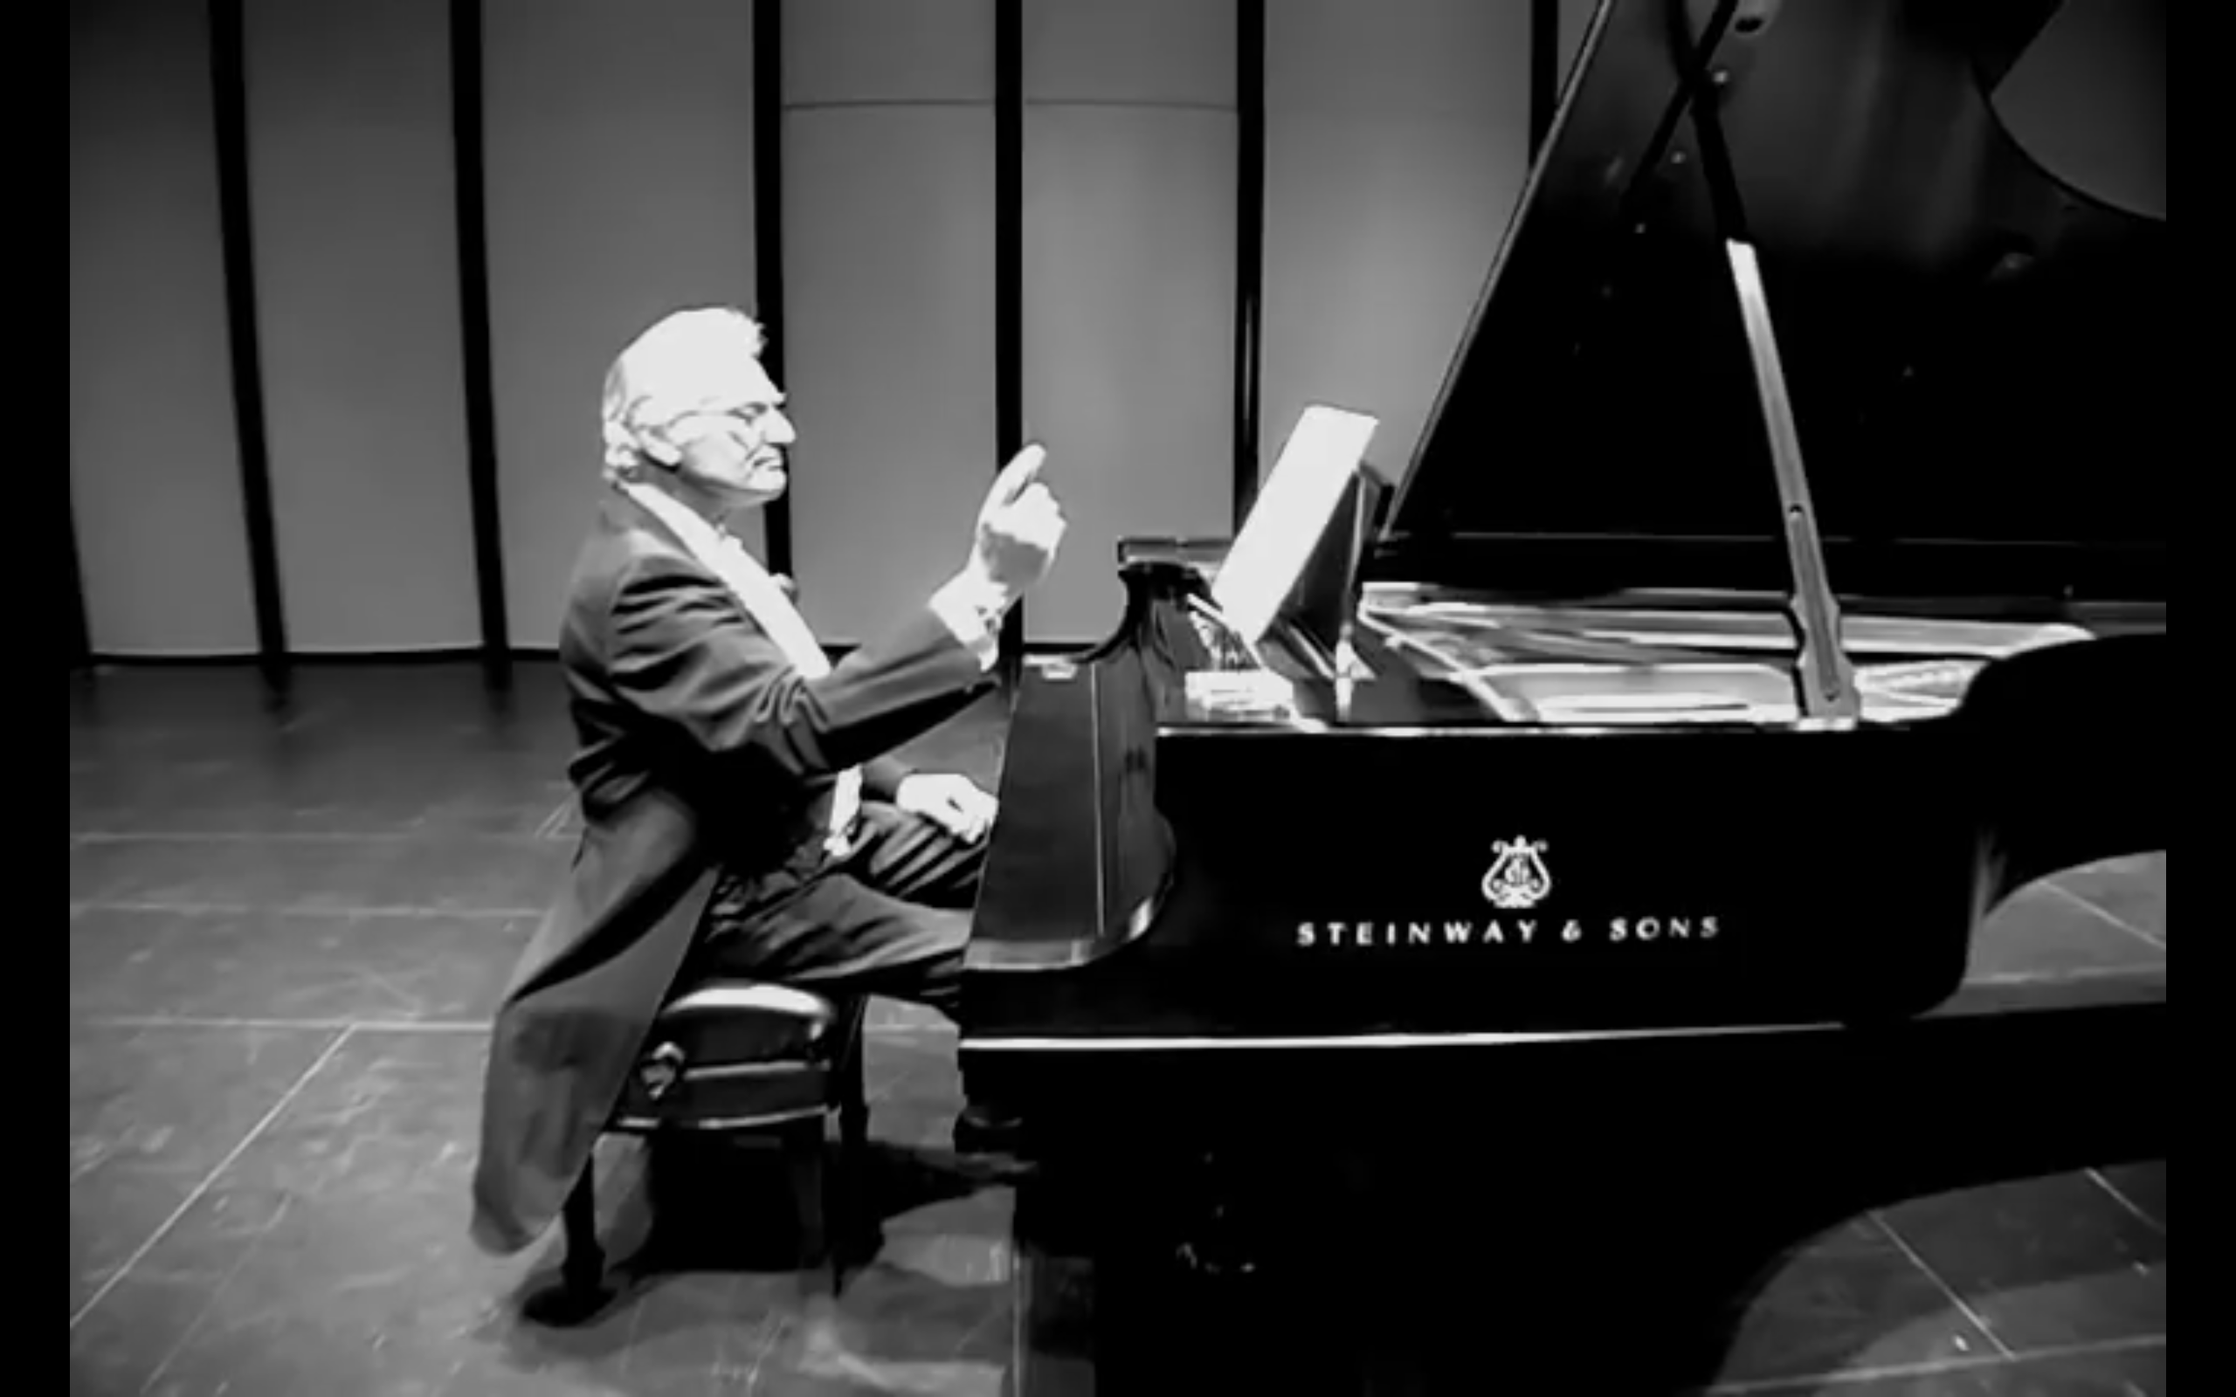
Notes:
William Marx

Slide 6
Notes:
Original: https://www.youtube.com/watch?v=u8lXRusTpY4

Slide 7
”They missed the point. There's no such thing as silence. What they thought was silence, because they didn’t know how to listen, was full of accidental sounds. You could hear the wind stirring outside during the first movement. During the second, raindrops began pattering the roof, and during the third the people themselves made all kinds of interesting sounds as they talked or walked out.”
John Cage

Slide 8
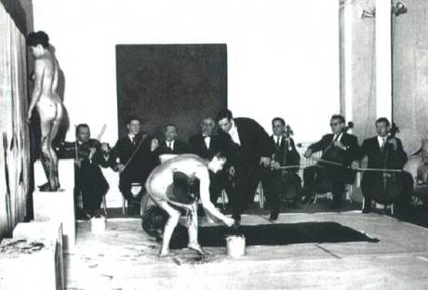
Notes:
Review of Yves Klein’s The Monotone-Silence Symphony:
On a clear night in March at ten pm sharp a crowd of one hundred people, all dressed in black tie attire, came to the Galerie International d'Art Contemporain in Paris. The event was the first conceptual piece to be shown at this gallery by their new artist Mr. Yves Klein. The gallery was one of the finest in Paris. Mr. Klein in a black dinner jacket proceeded to conduct a ten piece orchestra in his personal composition of The Monotone Symphony, which he had written in 1949. This symphony consisted of one note. Three models appeared, all with very beautiful naked bodies. They were then conducted as was the full orchestra by Mr. Klein. The music began. The models then rolled themselves in the blue paint that had been placed on giant pieces of artist paper - the paper had been carefully placed on one side of the galleries' wall and floor area - opposite the full orchestra. Everything was composed so breathtakingly beautifully. The spectacle was surely a metaphysical and spiritual event for all. This went on for twenty minutes. When the symphony stopped it was followed by a strict twenty minutes of silence, in which everyone in the room willingly froze themselves in their own private meditation space. At the end of Yves' piece everyone in the audience was fully aware they had been in the presence of a genius at work, the piece was a huge success! Mr. Klein triumphed. It would be his greatest moment in art history, a total success. The spectacle had unquestionable poetic beauty, and Mr. Kleins' last words that night were, "THE MYTH IS IN ART".

Slide 9
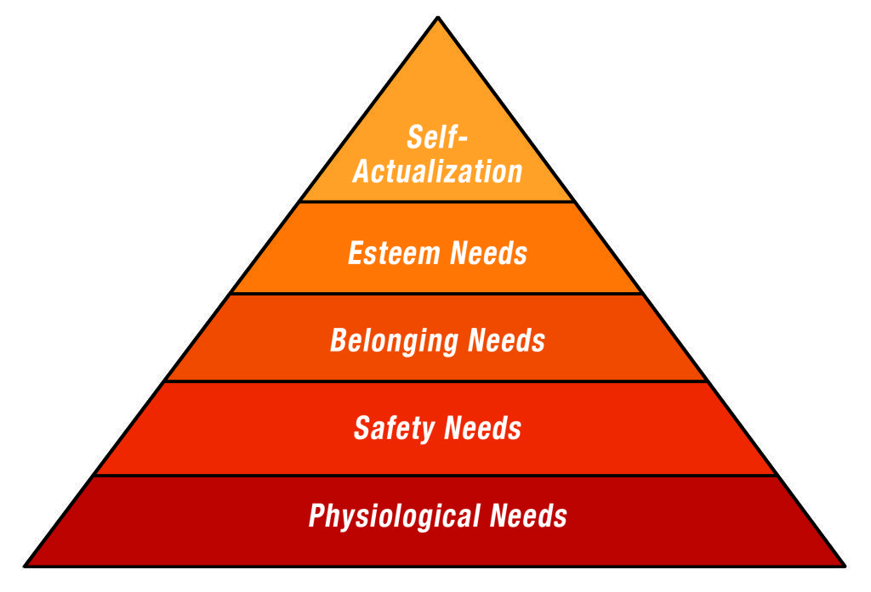
Notes:
Maslow's hierarchy of needs

Slide 10
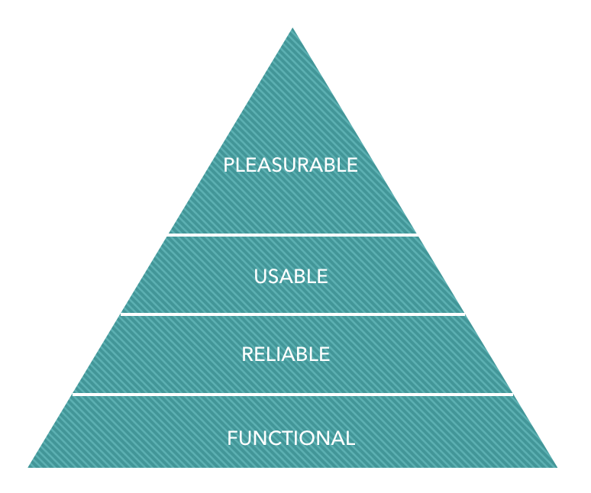
Notes:
Aaron Walter’s hierarchy of user needs, from his book, Designing for Emotion

Slide 11
Notes:
https://inclusivedesignprinciples.org/

Slide 12
Inclusive Design Principles
Provide comparable experience
Consider situation
Be consistent
Give control
Offer choice
Prioritise content
Add value

Slide 13
Exclusive Design Principles
Provide comparable experience
Consider situation
Be consistent
Give control
Offer choice
Prioritise content
Add value
Provide a unique experience
Ignore situation
Be inconsistent/innovative
Take control
Offer the best possible solution
Prioritise identity
Add nonsense
Notes:
https://vasilis.nl/nerd/exclusive-design-principles/

Slide 14
Provide a comparable experience
Ensure your interface provides a comparable experience for all users, so people can accomplish tasks in a way that suits their needs without undermining the quality of the content.

Slide 16
alt="Three hot air balloons. One of the balloons is close, two are in the distance. They have black and white vertical stripes. There is a cloud. Behind the cloud is the sun."

Slide 17
alt="Three hot air balloons hang together in a calm, sunny sky"

Slide 18
alt="Three hot air balloons hang together in a calm, sunny sky"
“I used to have sight so I appreciate descriptive alt text on decorative images.”
- Léonie Watson

Slide 19
Be consistent
Use familiar conventions and apply them consistently. Familiar interfaces borrow from well-established patterns. These should be used consistently within the interface to reinforce their meaning and purpose. This should be applied to functionality, behavior, editorial, and presentation.

Slide 20
”The only reason I didn’t buy car insurance with this company is because they are using normal form elements on the site and not nicely designed ones.”
Ian Pouncey, just now

Slide 21
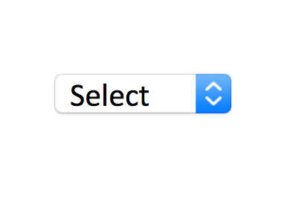
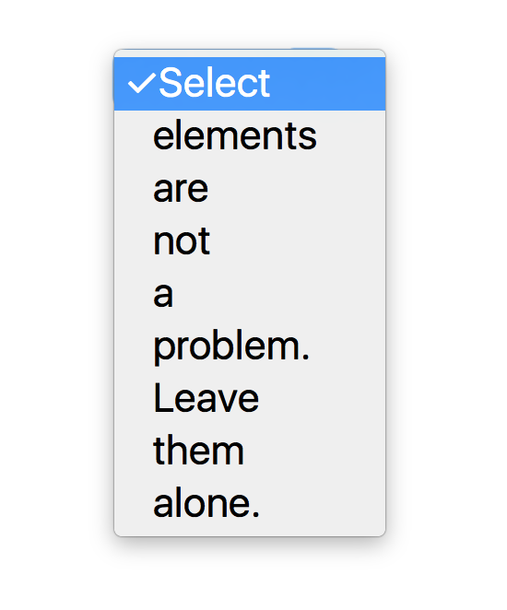

Slide 23
The WebAIM Million
WCAG Failure Type | # of home pages | % of home pages
Low contrast text | 852,868 | 85.3%
Missing alternative text for images | 679,964 | 68%
Empty links | 581,408 | 58.1%
Missing form input labels | 528,482 | 52.8%
Missing document language | 329,612 | 33.1%
Empty buttons | 250,367 | 25%
Notes:
https://webaim.org/projects/million/

Slide 24
The WebAIM Million
Home pages with ARIA present averaged 11.2 more detectable errors than pages without ARIA.

Slide 25
Indulgence budget

Slide 26
Add value
Consider the value of features and how they improve the experience for different users. Consider device features such as voice, geolocation, camera and vibration API's, and how integration with connected devices or a second screen could provide choice.

Slide 27
Add value
Make focus styles beautiful and not just functional
Enable speech input for search fields
Allow people to show or hide their password in forms
Add geolocation for maps or localised content

Slide 28
Accessible user experiences in 4’33”
Ian Pouncey

